Slide 1
Develop a strategic data-driven marketing recommendation aimed at converting Casual members to Annual membership thereby maximizing the overall number of annual subscriptions for cyclistics.
Presenter: Mr Matthew Ternenge Beeun
Date Updated: Friday, 17th October, 2025

Slide 2
Table of contents
1. Title of Presentation
2. Table of Content
3. Goal of the Analysis
4. Data Analysis
5. Recommendations/Conclusion
6. Appendix

Slide 3
Goal: Understand how casual and annual members use Cyclistic differently to inform a new marketing strategy focused on conversion.
Top line findings: Two distinct products, two distinct users.
Annual Members: Use the service as a Utility (Commuting).
Casual Riders: Use the service as Leisure (Recreation).
The Opportunity: By targeting the high-value leisure usage, we can convert a significant portion of the Casual Rider base.

Slide 4
Casual riders are not just infrequent users; they are users who pay a significant premium for their long trips, creating a major cost-saving incentive for conversion.
Total ride length
10.8M
Annual Avg. Casual Avg.
11.47 38.48

Slide 5
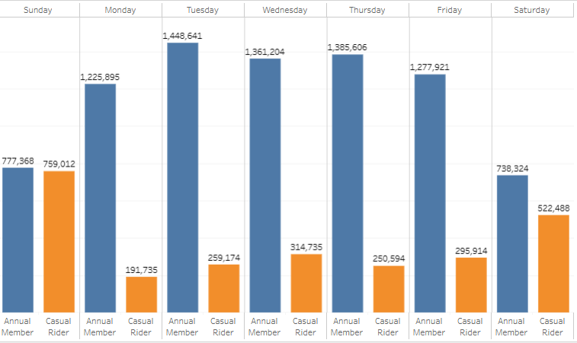
Total Rides by days of the Week
Annual Members (Blue): Peak usage occurs Mon-Fri, with a clear drop-off on weekends. (Utility)
Casual Riders (Orange): Peak usage occurs dramatically on Saturday and Sunday. (Leisure)
Conclusion: The highest-value conversion moment is on the weekend, when riders are actively engaged in their longest, most expensive trips.

Slide 6
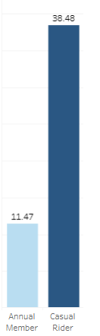
Average Duration by Rider Type
Analysis: Average ride duration for Casual Riders is over 3x longer than for Annual Members
Casual Riders pay by the minute/hour after the first 30 minutes, they are overpaying for their chosen usage style.
Recommendation Focus: Our strategy must directly communicate the cost efficiency of membership for their existing weekend leisure habit.

Slide 7
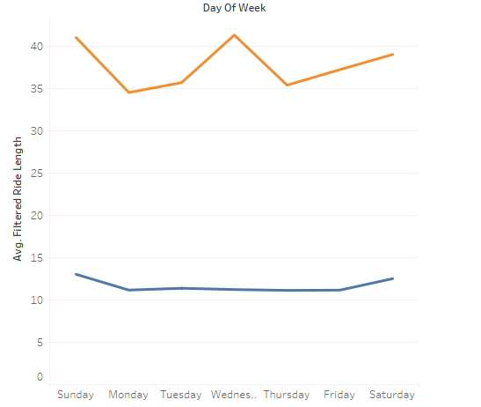
Average ride Difference across weeks for the two members
Casual riders are more active on weekeneds than week days
It only proves one thing that they don’t use their bikes for commuting but leisure.
We can engage them in activities that we force them to come out during weekdays too by discounting and notifying them the saving cost of commuting

Slide 8
Actionable Recommendations
Introduce the weekend Pass: Targeting Existing Behaviour
Geo targeted Locations: Intercepting users at their source
Real Time Cost Saving Communication: Driving Immediate Conversion
What: A discounted, auto-renewing membership covering Friday evening through Sunday.
Why: Meets the Casual Rider where they are, offering a low-friction entry point that directly saves them money on their current primary usage pattern.
What: Integrate a mobile app/email notification that triggers immediately after a long, expensive casual trip.
Why: Leverages the moment of financial pain by showing: "You just spent $X. An Annual Membership would save you $Y after only Z more similar rides."
What: Focus digital and physical advertising at stations identified as high-casual-volume tourist and leisure hubs (e.g., parks, lakefronts).
Why: Intercepts the target user pool immediately before or after they begin their expensive leisure trip.

Slide 9
Expected Impact and Next Steps
Next Steps:
Pilot the Weekend Pass in Q1 [Next Year].
Develop the A/B testing framework for the Real-Time Savings notification.
Utilize start station data to finalize the Geo-Targeting locations for Q2 marketing campaigns.
Expected Impact:
A 10% conversion of our current Casual Rider volume through the Weekend Pass alone could increase our annual recurring revenue (ARR) by [X amount, based on subscription pricing].

Slide 10
Thank You
Questions?

